Slide 2
Introduction
“For any US city, how can I maximize returns on my limited stay?”
Why it matters…
Travel planning – which attractions can easily be packaged together?
Hotel companies – best locations to build hotels?

Slide 3
Approach
Shortest path problem
Nodes:
Tripadvisor attraction reviews
Yelp restaurant reviews
Edges:
Open Street Map transportation network

Slide 4
Approach
Shortest path problem
Nodes:
Tripadvisor attraction reviews
Yelp restaurant reviews
Edges:
Open Street Map transportation network

Slide 5
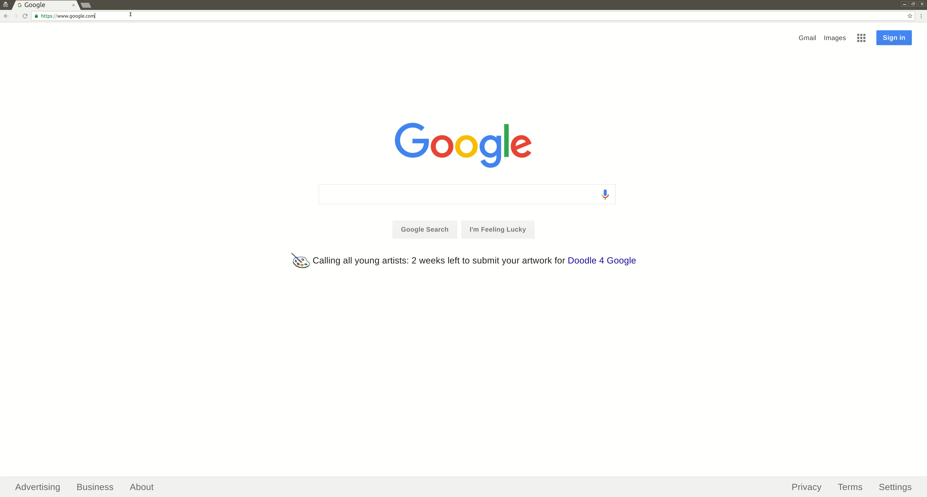
Nodes – Scraping TripAdvisor
https://scrapy.org/

Slide 6
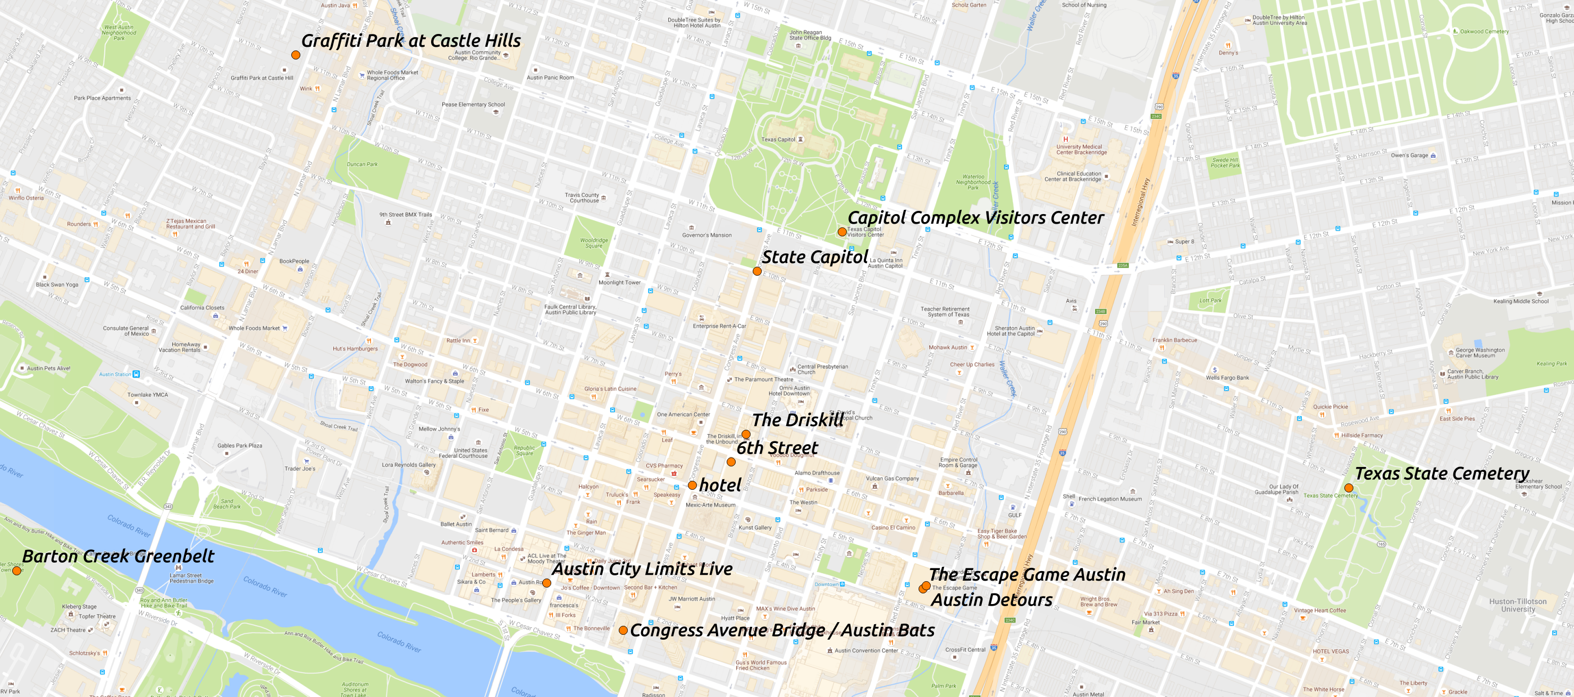
Nodes – Geocoding Attractions
Geocoder → Addresses to Lat/Lon coordinates
https://pypi.python.org/pypi/geocoder

Slide 7
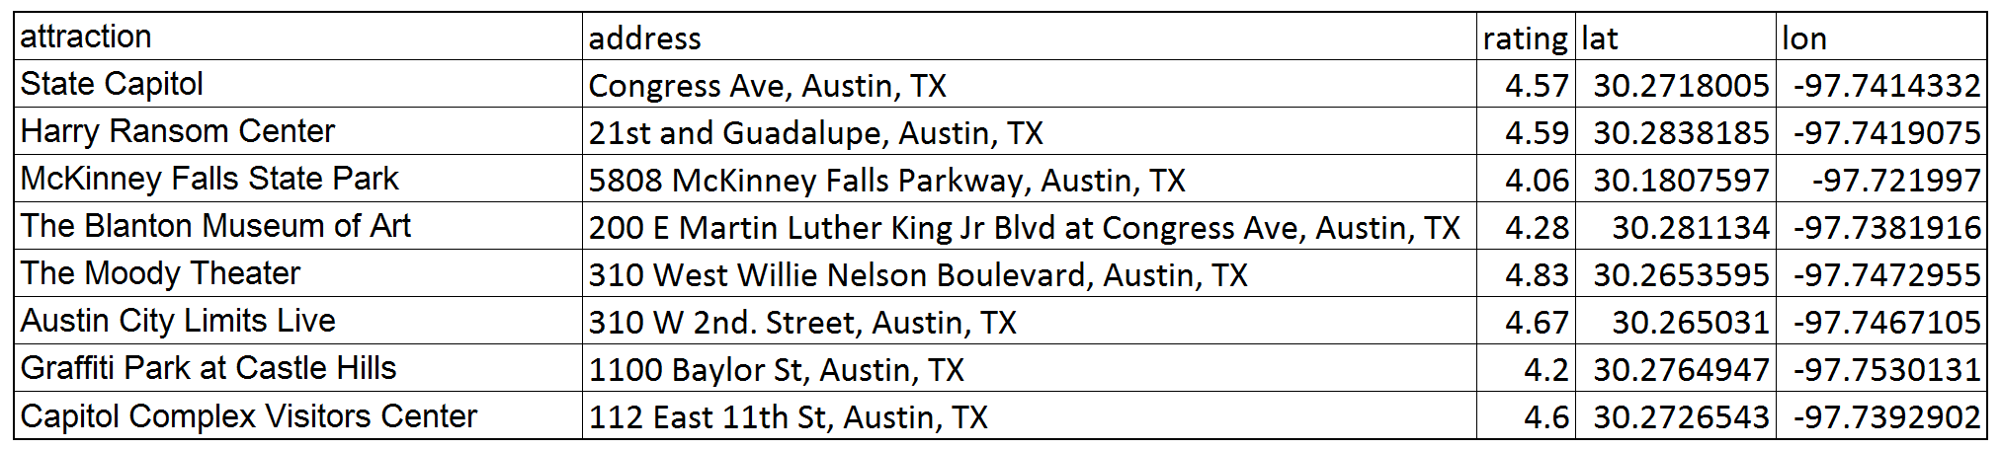
Nodes – Read as Pandas DataFrame
Scrapy Item Exporters → “CSV” option

Slide 8
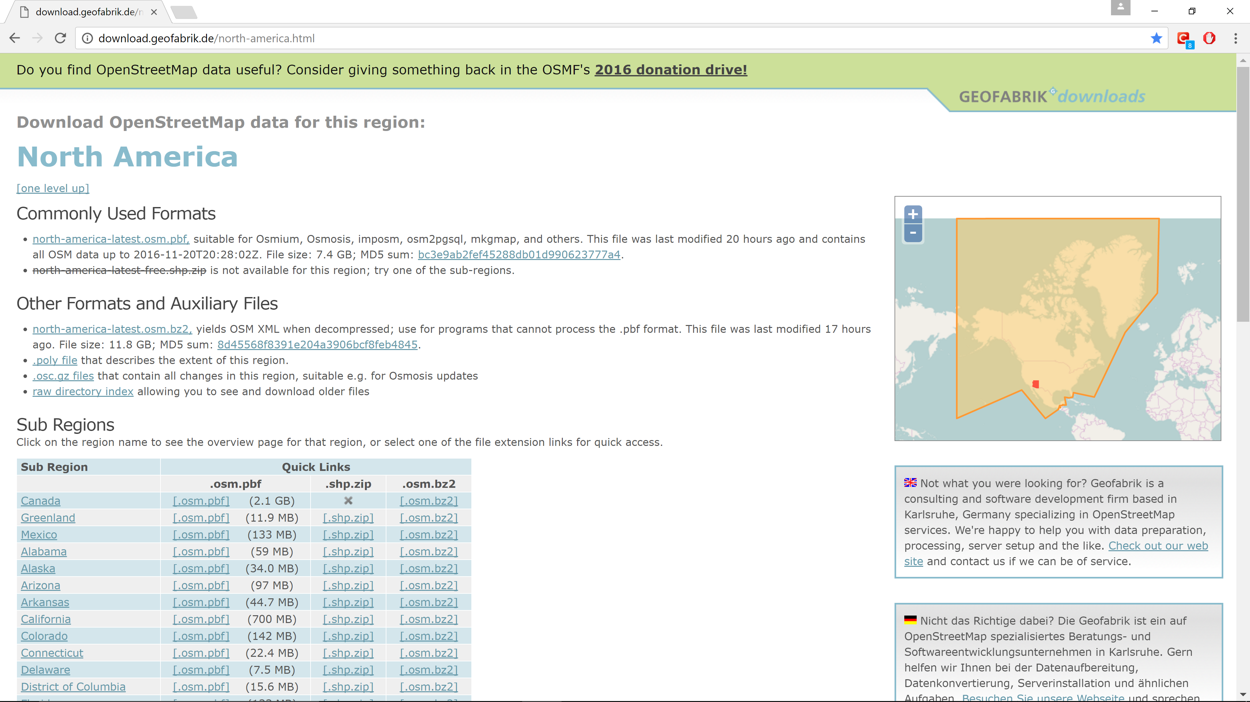
Edges – Data Retrieval
http://download.geofabrik.de/north-america.html

Slide 9
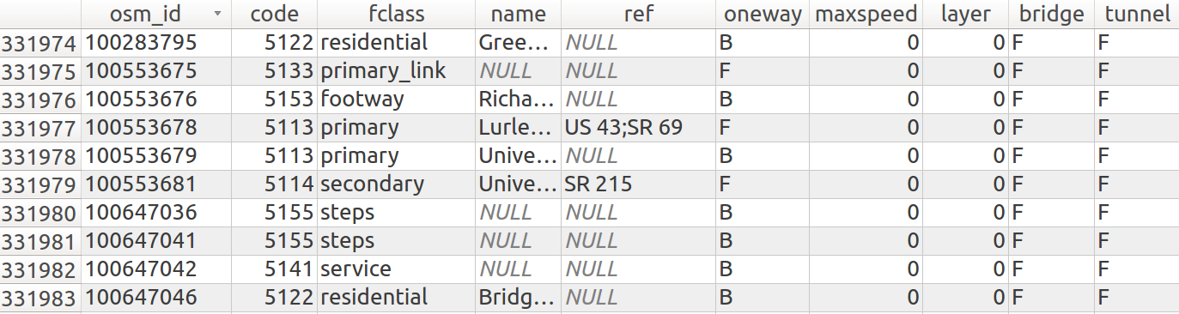
Edges – Pre-processing with PyQGIS
Raw data
Coordinate system: World Geodetic System 1984 (WGS84)
http://docs.qgis.org/testing/en/docs/pyqgis_developer_cookbook/

Slide 10
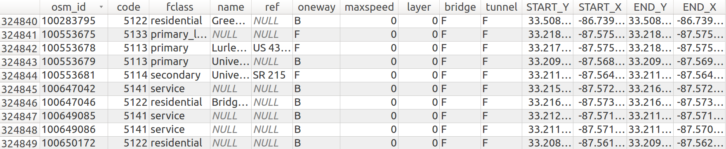
Edges – Pre-processing with PyQGIS
Select relevant roads by ‘fclass’ attribute
Retrieve latlon coordinates for each road’s start/end nodes

Slide 11
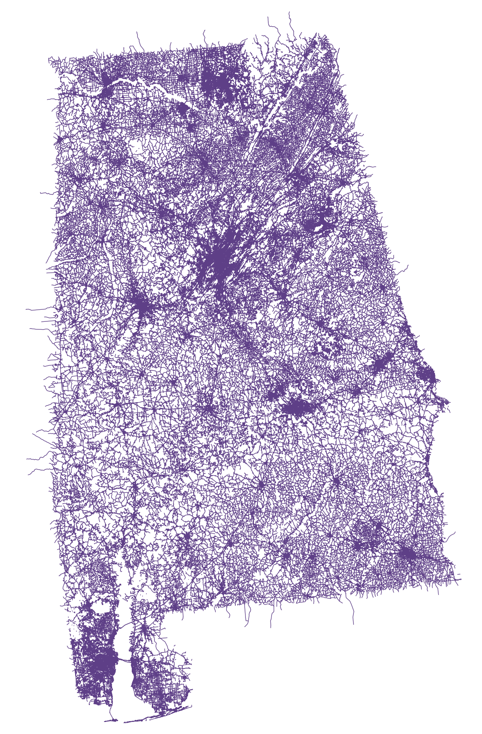
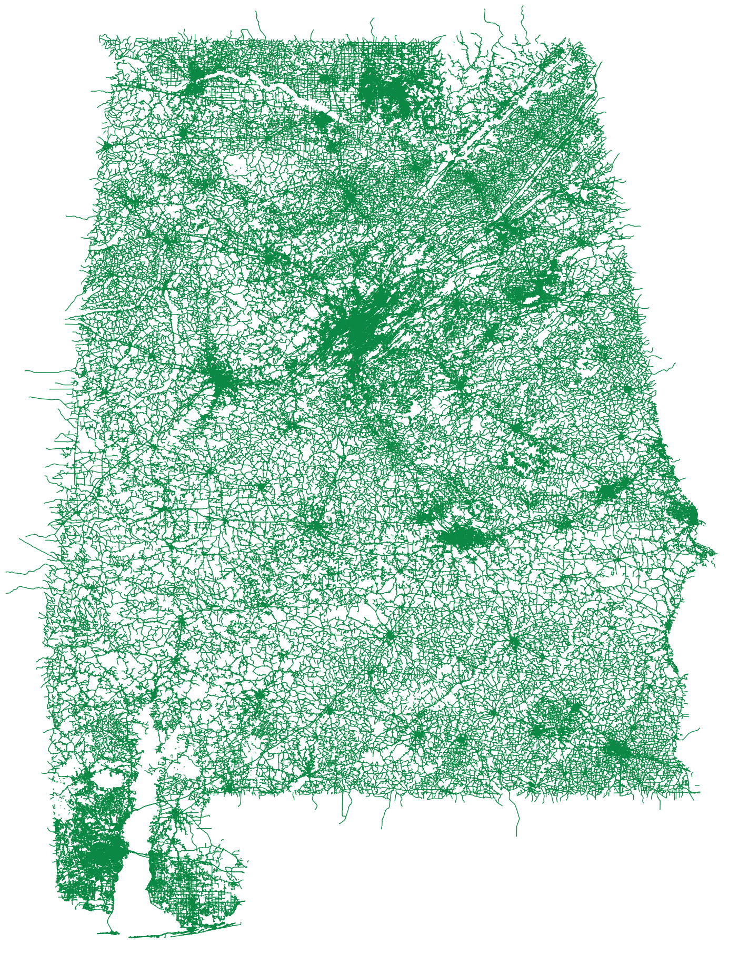
Edges – Pre-processing with PyQGIS
Reproject coordinates to North American Datum of 1983 (NAD83)
Distances calculated in meters
WGS84
NAD83

Slide 12
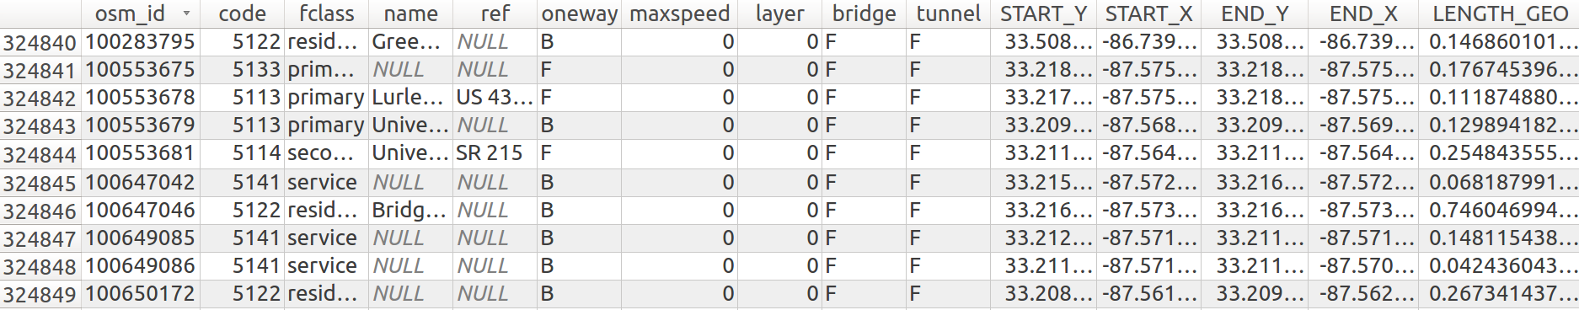
Edges – Pre-processing with PyQGIS
Add length (in miles)

Slide 13
Edges – Pre-processing with PyQGIS
Reproject back to WGS84 for later visualizations
NAD83
WGS84

Slide 14
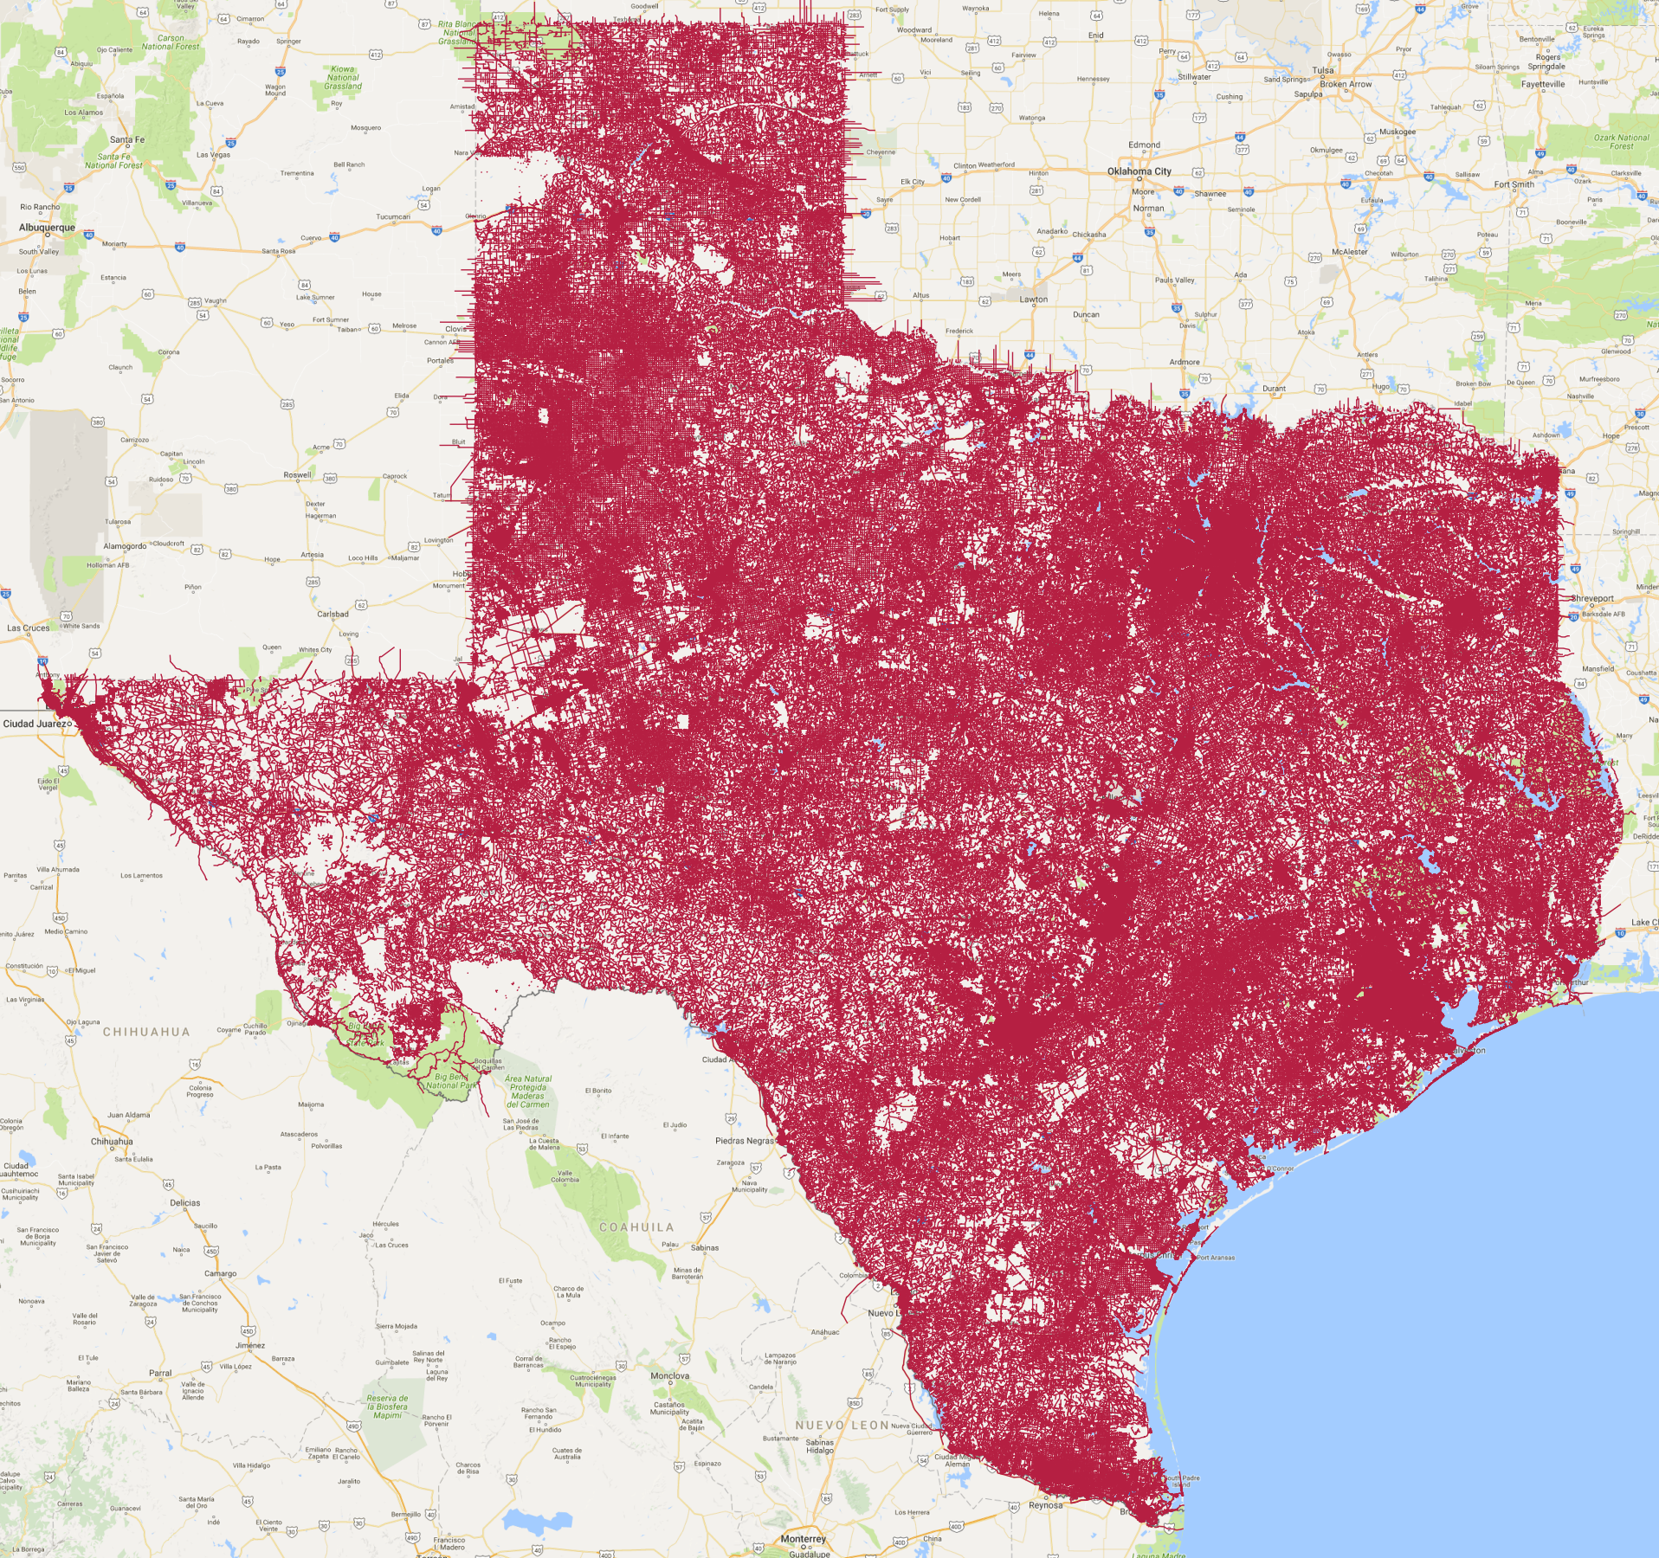
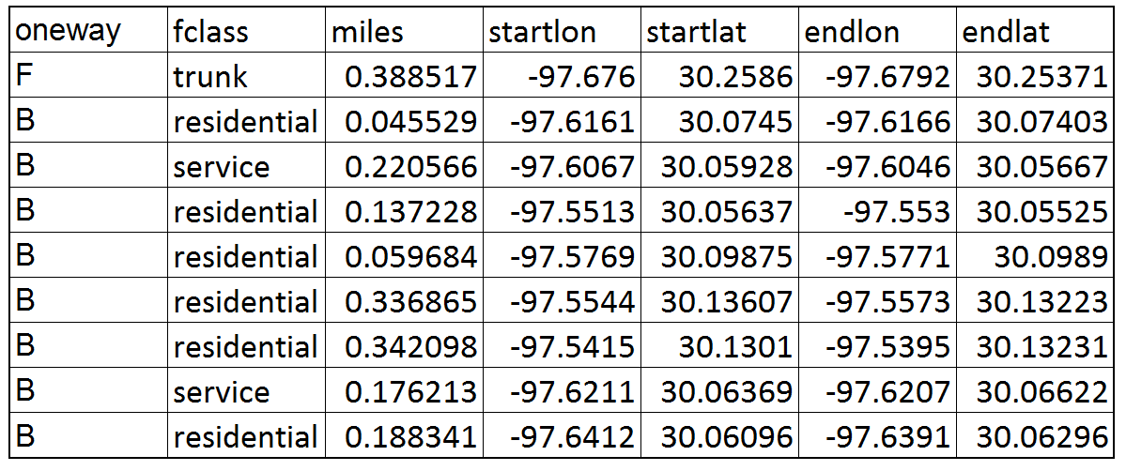
Edges – Convert to Pandas DataFrame
Shapefile module → convert shapefile to pandas dataframe
https://pypi.python.org/pypi/pyshp

Slide 15
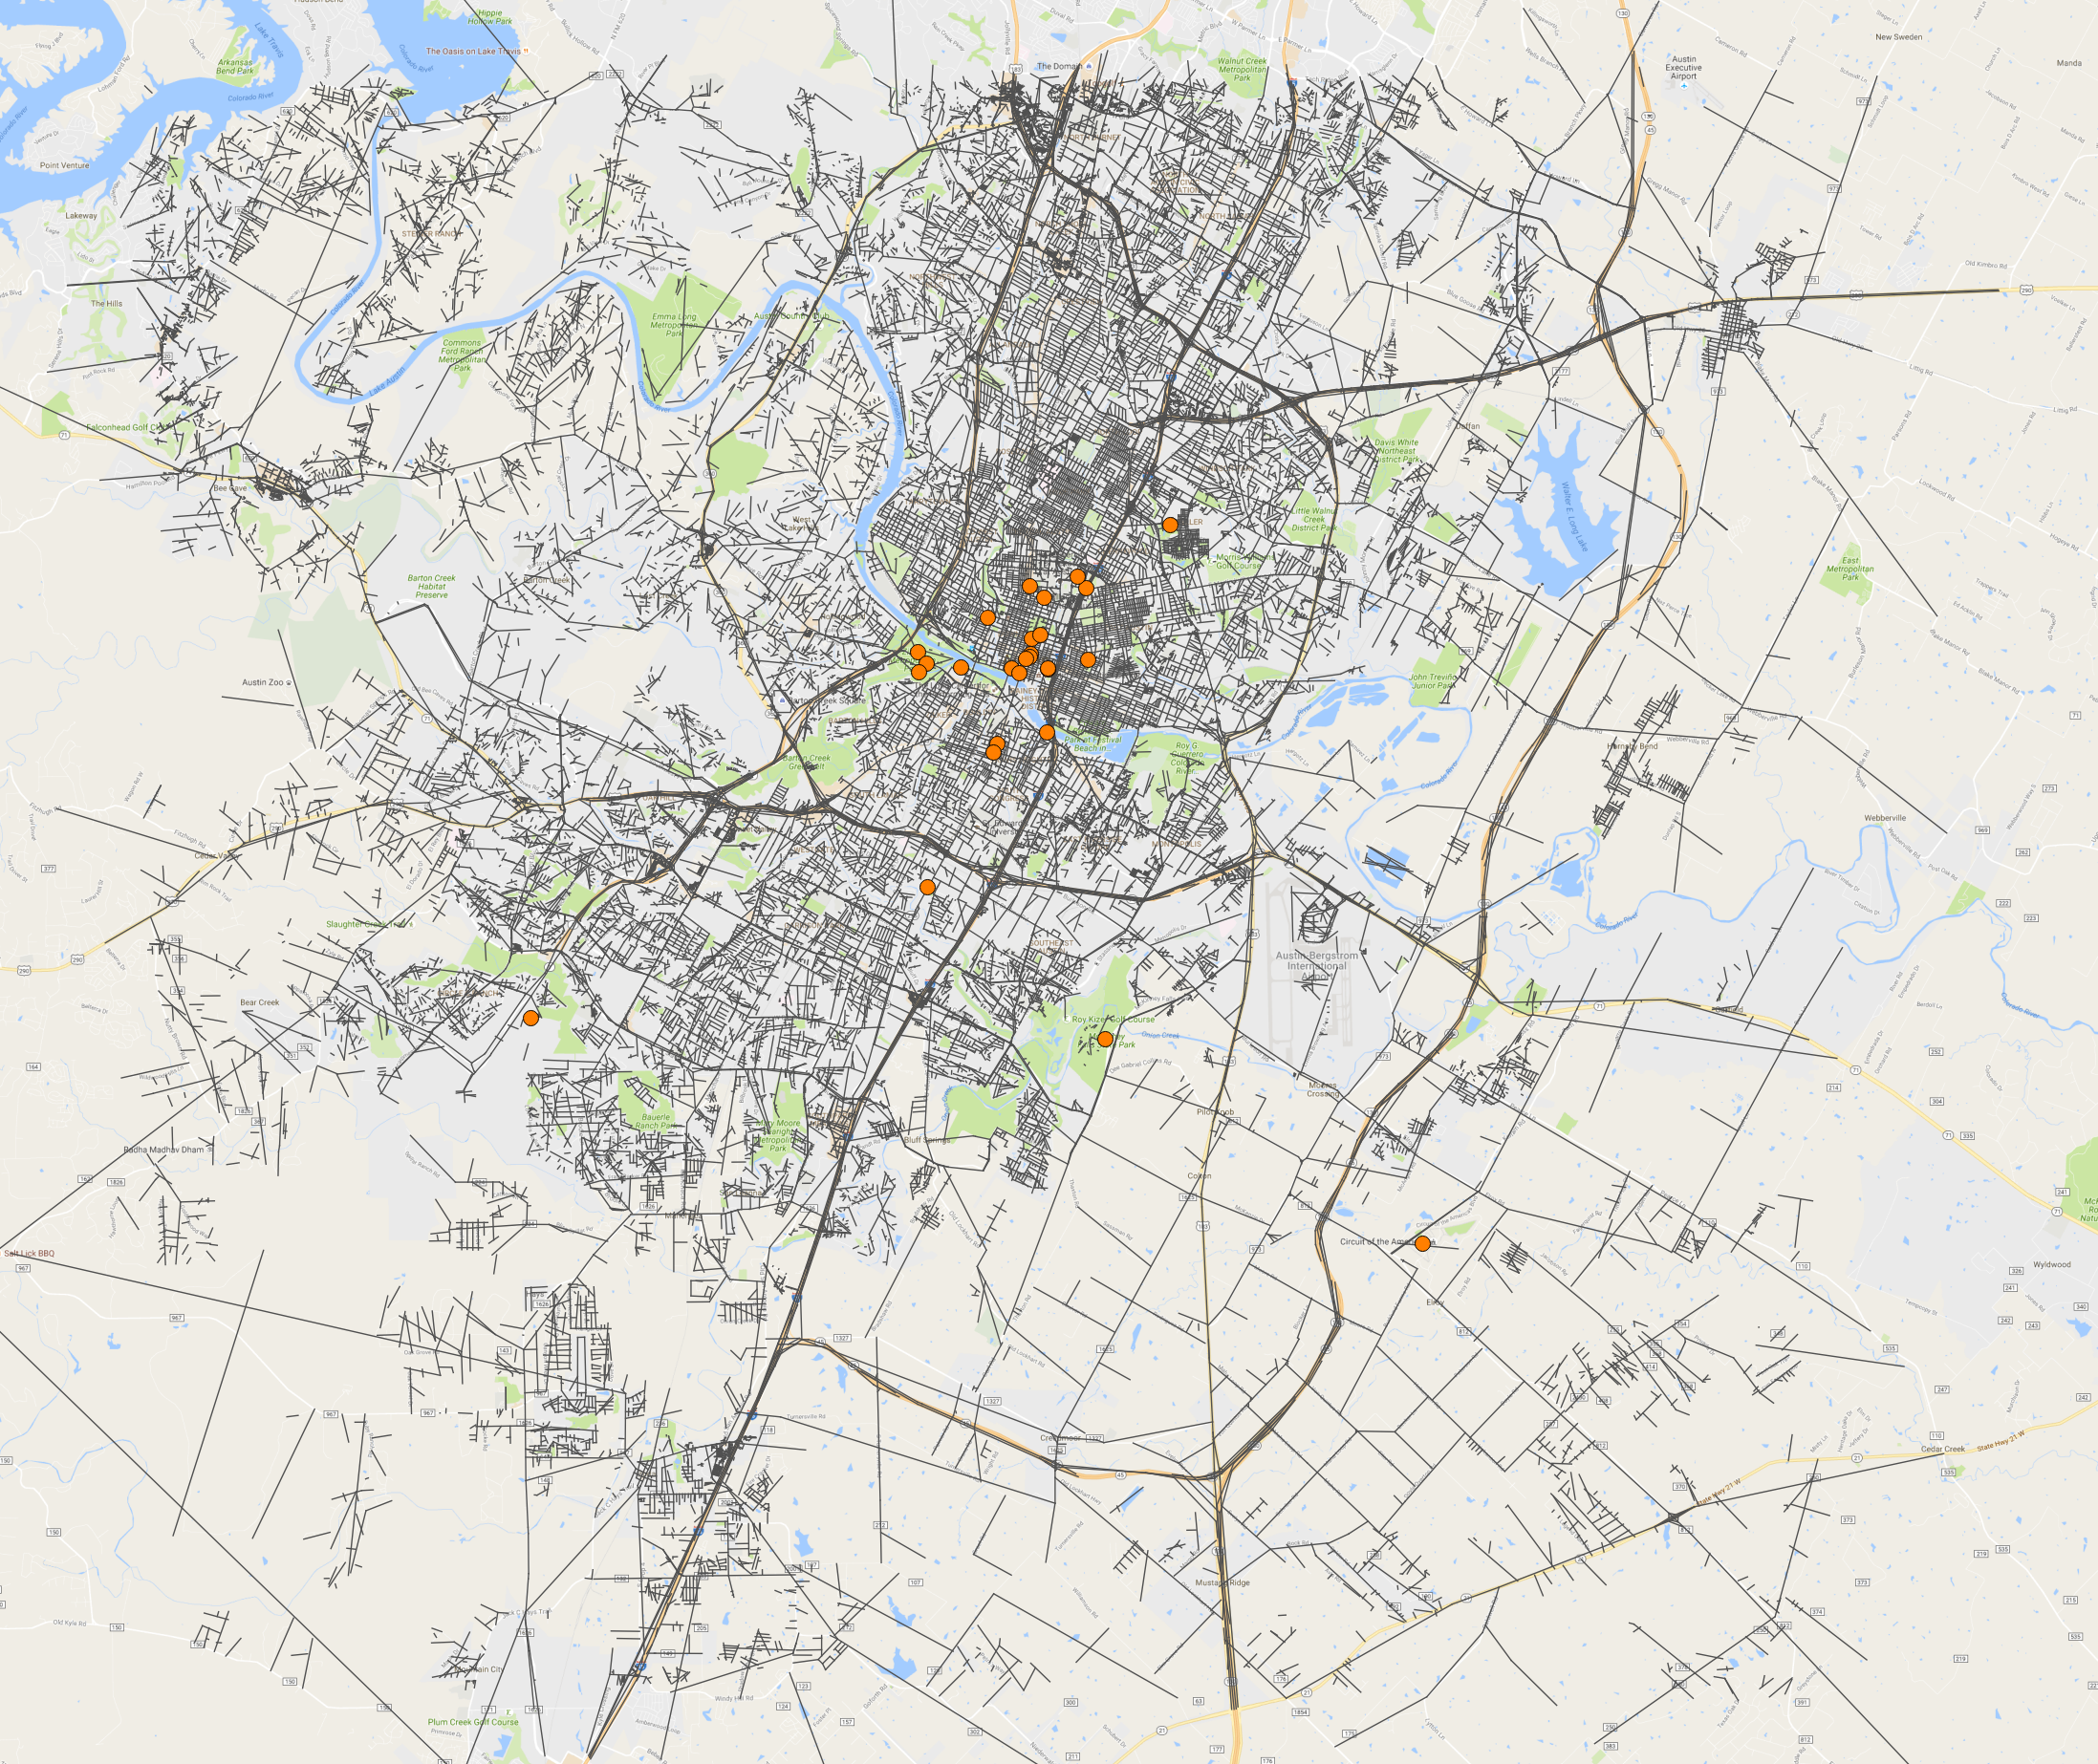
Edges – Clip Shapefile
GDAL/OGR → Clip edges shapefile to attractions extent
Shapely → Convert point latlons to Well-Known-Text
*Note:
GDAL - Geospatial Data Abstraction Library
OGR - OpenGIS Simple Features Reference Implementation
https://pypi.python.org/pypi/GDAL/
https://pypi.python.org/pypi/Shapely

Slide 16
Melissa’s stuff…

Slide 17
Literature Review
How do other people answer this problem? Tell us a little about how other people go about answering the problem you selected. This is important because it gives us a basis on which to think about the project you created.

Slide 18
How did you mathematically model the real world? How did you translate the realworld problem into a mathematical formulation?

Slide 19
Sudesh’s stuff…

Slide 20
Analysis Design. Tell us about the analysis you designed. What data did you use? What does your software do? How did you test that it works correctly? What are the key experiments / questions you answered using your software?
Perhaps talk about how we compared with Google Maps results to verify distances and travel times (compared to our outputs).

Slide 21
Analysis Results. Tell us the interesting results of your analysis. What are the insights you gained? Teach your audience about the things you discovered.

Slide 22
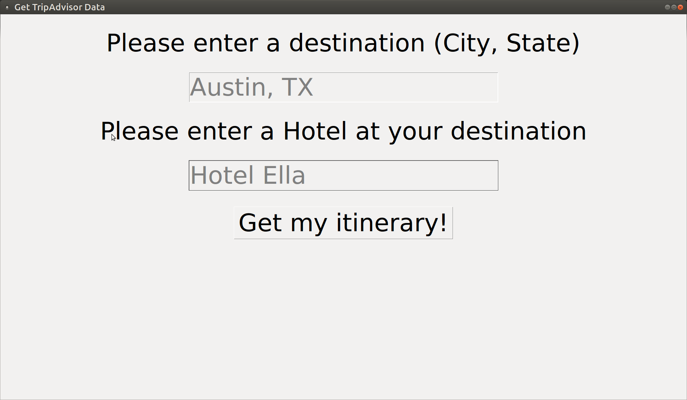
Calling the Script
Tkinter GUI
Pass arguments by calling python script via command-line
'python scrape.py –city=Austin –state=TX ' –base=Hotel_Ella’

Slide 23
Summary and Conclusion. Give us just one slide on the limitations of your analysis. In other words, if you had 3 additional months to work on this, what else would you have done to make the results better?
Limitations…
Limited to USA
Intended to make pip module, but lots of dependency requirements and a lot of data (shapefiles) needed to do analysis

